Slide 1
20XD24 - OBJECT ORIENTED PROGRAMMING
Chapter - II

Slide 2
Outline
Function Prototyping
Call by Reference - Return by reference
Inline functions
Default, Const Arguments
Function Overloading

Slide 3
Functions
A function is a collection of statements that performs a specific task
A function groups a number of program statements into a unit and gives it a name. This unit can then be invoked from other parts of the program
Library functions or built-in functions
  Library functions are not required to be written by us
  The standard C++ library is collection of various types of functions which perform some standard and predefined tasks
User defined functions
  Programmers can create their own function to perform a specific task
  Example: sum (), fact () , show(), display() and etc.,

Slide 4
User-Defined Functions
Three components
  Function declaration (or) Function Prototype
  Function definition
  Function call
  1. Function declaration (or) Function Prototype
Function declarations (also called prototypes) since they provide a model or blueprint for the function
Tells the compiler - The information the return type, the name, the number and types of any arguments - is also sometimes referred to as the function signature
Syntax
return_type function_name (type1 arg1, type2 arg2, …type n argn);

Slide 5
User-Defined Functions
Return-type
  Specifies the type of value that a function returns using the return statement
  It can be any built-in or user-defined data type
  If no data type is specified the function is assumed to return an integer result
Function-name
  Must follow same rules of variable names in C++
Argument declaration
  It is a comma-separated list of variables that receive the values of the argument when function is called
  If there is no argument declaration the bracket consists of keyword void

Slide 6
User-Defined Functions
Examples – Function Prototype
  int factorial (int n);
  int factorial (int); // mentioning the argument name is optional
  factorial (int); // default return type is int
  void print(void); // 1st void means no value returned, 2nd void
  means no input arguments
  void print( );
  int sum(int a, int b, int c);
  int fn(float, float);
  void draw_circle(void);
  double find_area(double r);

Slide 7
User-Defined Functions
2. Function Definition
A function definition requires all parts of the function
A header - which includes the function return type, the name of the function, and an argument list (formal parameters), and
A function body - The function body contains the code that carries out the function's tasks
A function definition is distinguished from a prototype, which does not have a body, and is distinguished from a function call, which does not have the data type of the arguments or the return value

Slide 8
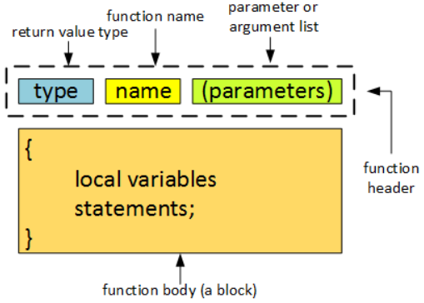

User-Defined Functions

Slide 9
User-Defined Functions
3. Function Call
A function call is a statement that causes a function to execute
When a function is called, the program branches to that function and executes the statements in its body
The parameters in the function call are called actual parameters
Function call does NOT have typing information
It is possible to have many functions and function calls in a program
Syntax
function_name(variable1, variable2,…);
(or)
variable_name = function_name(variable1, variable2,…);
cout<<function_name(variable1, variable2,…);

Slide 10
Anatomy of Functions
Return Type
#include <iostream>
using namespace std;
#define PI 3.14159
double find_area(double r);
int main(void){
double radius, area;
cout<<"Enter radius : ";
cin>>radius;
area = find_area(radius);
cout<<"The area is”<<area;
}
double find_area(double r){
double a;
a = PI*r*r;
return (a);
}
Input
Enter radius : 10
Output
The area is 314.16
Formal argument
Function Declaration/Prototype
Actual argument
Function call
Caller function
Function Header
Local declarations
Function Definition
Function Body
Executable Statements
Called function

Slide 11
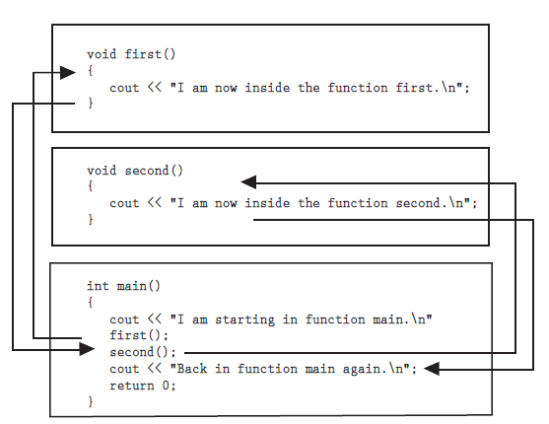
Functions

Slide 12
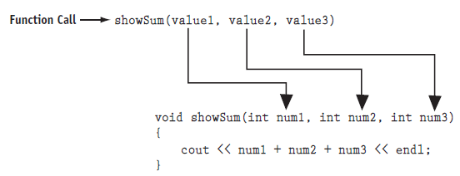
Parameter Passing Mechanisms
Parameter passing – In C++, data are passed to a function using one of the following techniques
  pass by value or call by value
  pass by address or call by address
  Pass by Reference

Slide 13
1. Pass by value
When arguments are passed by value, a copy of the argument’s value is made and passed to the called function
Changes to the copy do not affect an original variable’s value in the caller
Pass-by-value should be used whenever the called function does not need to modify the value of the caller’s original variable
This prevents the accidental side effects (variable modifications) that so greatly hinder the development of correct and reliable software systems

Slide 14
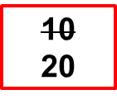
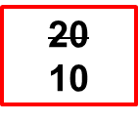
1. Pass by value
#include<iostream.h>
void swap (int , int ); /*function prototype */
int main ()
{
int a, b;
cout<<“\n Enter the values of a and b: “;
cin>>a>>b;
swap (a, b); /*function calling*/
cout <<“\nFrom main The Values of a and b”<< a<<b;
}
void swap (int x, int y) /* function definition */
{
int temp;
temp=x;
x=y;
y=temp;
cout<< “\n The Values of a and b after swapping<<a<<b;
}
a b
10
20
11223 22446
x y
temp
10
77854 67531
88553

Slide 15
1. Pass by value
Advantages
  A function is free to modify a parameter without impacting or inadvertently affecting the data at the calling location
  Flexible - the function argument may be any expression - not just a variable. It is the value of the expression that is copied to the function parameter
Disadvantages
  when a function changes a parameter passed by value, that change cannot be propagated back to the caller through the parameter even when we want to do so
  Pass by value is implemented by passing a copy of the data to the function. As a consequence, as the size of the data increases, for example, a structure with many fields, it takes increasingly longer to copy the data to the function

Slide 16


2. Pass by Address(Pointer)
The address of actual argument is copied into the formal parameter
Changes made to the formal parameter will affect the argument used to call the function
void swap (int *px, int *py)
{
int temp;
temp = *px;
*px = *py;
*py = temp;
}
swap
px
py
temp
1024
9921
3
8894
2265
1137
int main ( )
{
int i = 3, j = 5;
swap(&i, &j) ;
cout<< i<< j;
return 0;
}
main
i
j
1024
9921
5,3

Slide 17
2. Pass by Address
Advantage
  Time needed to perform the pass the address of data is independent of the size of the data - passing a large structure by pointer takes no more time than passing a small structure
Disadvantages
  Pass by pointer only works with variables (ie., actual parameters must be variables)
Note:
  It is possible to change the value stored in an argument, even when doing so is undesirable - however, the const keyword can be used to prevent this from happening

Slide 18


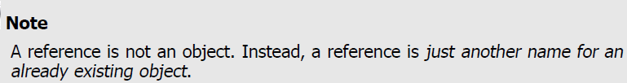
3. Pass by Reference
What is a reference?
  A reference defines an alternative name for an object
  A reference variable is an alias for another variable
  The unary operator & with type name identifies a reference
  Example
  int count = 1;
  int& r = count;
  Note: A reference must be initialized

Slide 19
3. Pass by Reference
Note:
The value of a reference can not be changed after initialization
  Ie., Once a reference is created, it cannot be later made to reference another object
It always refers to the object it was initialized
Null References can’t be created
Example
  int count1 = 1, count2=10;
  int &r = count1; // correct, r refers to variable count1
  ….
  int &r=count2; //error
  r= count2; // Is it Correct ? - incorrect

Slide 20

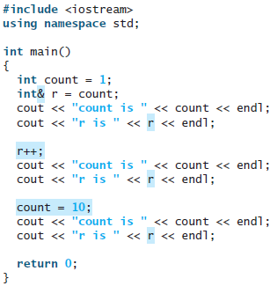


3. Pass by Reference
After a reference has been defined, all operations on that reference are actually operations on the object to which the reference is bound

Slide 21
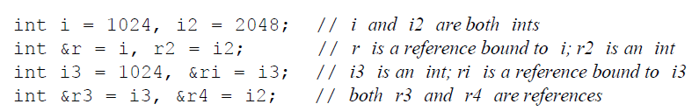
3. Pass by Reference
int i=1;
int &r=i; // r and i refer to the same int
int x=r; //x=1
r=2; //i=2
We can define multiple references in a single definition. Each identifier that is a reference must be preceded by the & symbol

Slide 22
3. Pass by Reference
Initializing a Reference
Reference should be initialized with explicitly giving it something to refer to
Some Exceptions - We need not initialize a reference when
  it is declared with extern
  it is a member of a class
  it is declared as a parameter
  in a function declaration or definition
  it is declared as a return type of a function

Slide 23

3. Pass by Reference
Reference to an object of different type
double dval=3.14159;
const int &Ir=100;
const int &Ia=dval
const double &dr=dval+1.0
A const reference can be initialized to an object of a different type (provided there is a conversion from one type to the other) as well as to non-addressable values such as literal const
For non-const reference, the same initialization are not legal

Slide 24
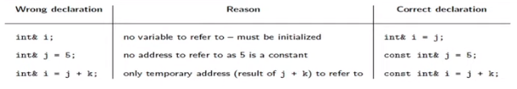
3. Pass by Reference
Note:
In the case of non-addressable values such as literal constants and objects of a different type, to accomplish this the compilers must generate a temporary object that the reference actually addresses but that the user has no access to it
Pitfalls in Reference

Slide 25
3. Pass by Reference
References and Pointers
References can be viewed as pointers without usual dereferencing notation
  int actualint=123;
  int *const intptr=&actualint;
  intptr is a constant pointer, one cannot make it point to another integer once it has been initialized to actualint
  same is true for references

Slide 26
3. Pass by Reference
References and Pointers
  References can’t be manipulated like pointers
  They don’t have pointer arithmetic
  They directly act on the object they refer to.
  With pointers, one can use the const keyword to declare constant pointers and pointers to constant

Slide 27
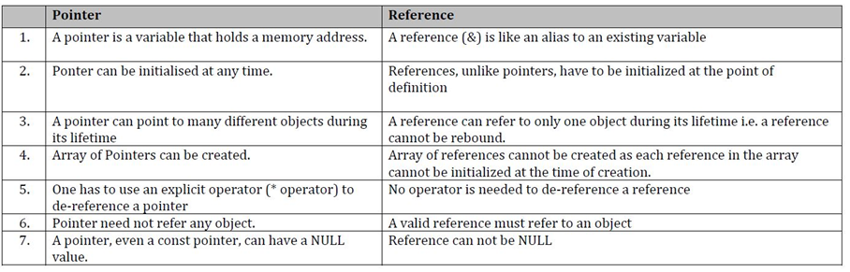
3. Pass by Reference
References vs. Pointers

Slide 28
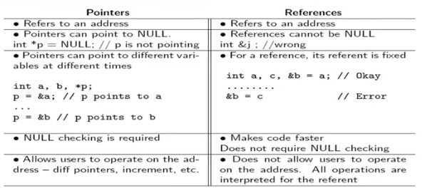
References vs. Pointers

Slide 29
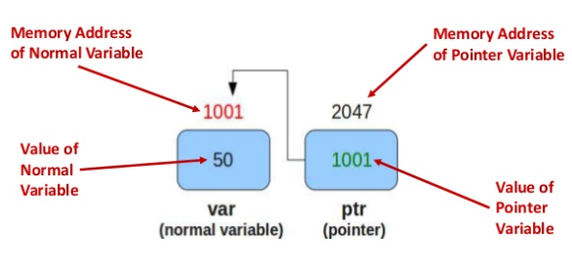
Pointer to a Constant
int var = 50, var2=100;
const int *ptr= &var;
*ptr = 1000; //error
ptr = &var2;
var=2000 //correct
Read only value
Cannot be changed using ptr

Slide 30
Constant Pointer
int var = 50, var2=100;
int *const ptr= &var;
ptr = &var2; //error
*ptr = 1000; // correct

Slide 31
Constant Pointer to Constant
int var = 50, var2=100;
const int *const ptr= &var;
ptr = &var2; //error
*ptr = 1000; // error
var = 2000; //correct

Slide 32
3. Pass by Reference
Reference to constant
One can declare a reference to a constant
  int actualint=123;
  const int& otherint = actualint;
This makes otherint a readonly alias for actualint. You can’t make any modification to otherint, only to actualint
One cannot declare a constant reference
  int &const otherint = actualint; //error
meaningless all references are constant by definition

Slide 33
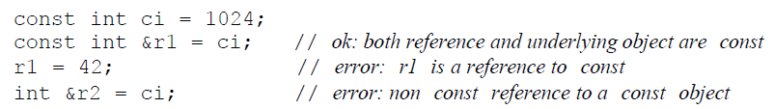
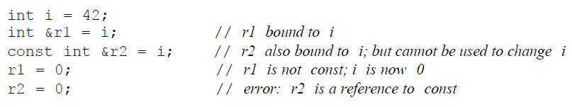
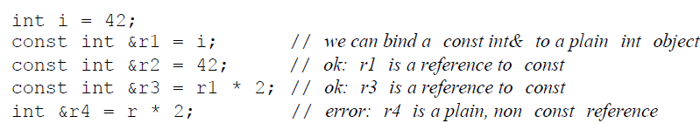
3. Pass by Reference

Slide 34
3. Pass by Reference
Which of the following initializations are legal? Explain Why?
(a) int i = -1, &r = 0;
(b) int *const p2 = &i2;
(c) const int i = -1, &r = 0;
(d) const int *const p3 = &i2;
(e) const int *p1 = &i2;
(f) const int &const r2;
(g) const int i2 = i, &r = i;

Slide 35
3. Pass by Reference
void swap (int&, int&); //prototype
main( )
{ int x=10,y=20;
cout<<“x=“<<x<<“ y=“<<y; output: x=10 y=20
swap (x, y);
cout<<“x=“<<x<<“ y=“<<y; output: x=20 y=10
}
x y
void swap (int &a, int &b)
{
int t;
t=a;
a=b;
b=t;
}
a
10
20
b
11223 22446
Call by Reference: In C++ it is possible to pass arguments by reference also. When we pass arguments by reference, the ‘formal’ arguments in the function become aliases to the ‘actual’ arguments in the calling function

Slide 36
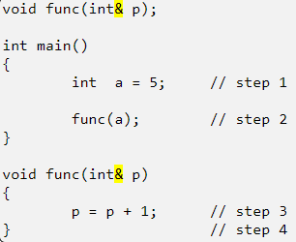
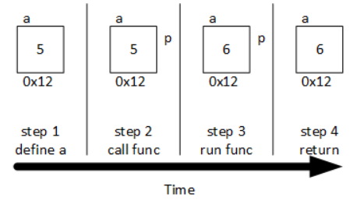
3. Pass by Reference
Pass by reference is efficient for large amounts of data, allows the function to change the data
The const keyword can also be use with pass by reference to prevent a function from changing a parameter

Slide 37
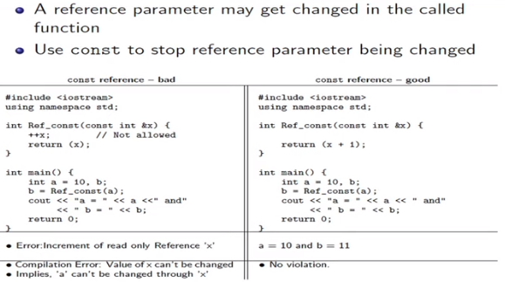
3. Pass by Reference
Reference Parameter as const

Slide 38
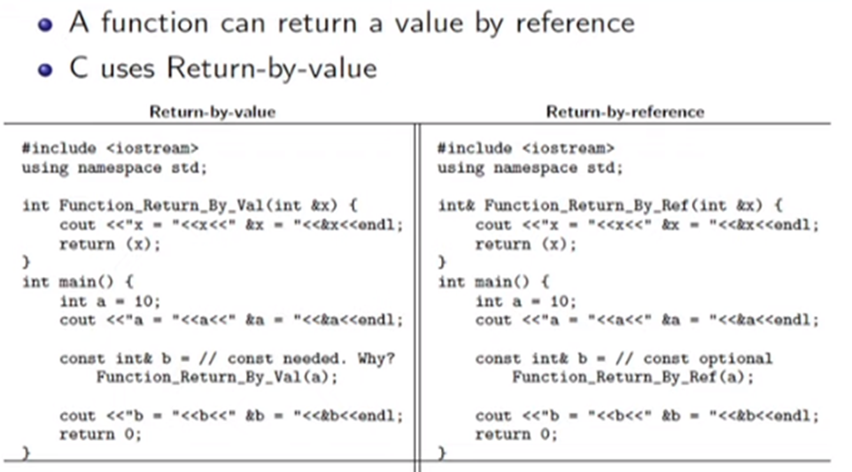
Return by Reference

Slide 39
References as Return values
Reference can also be used to return values from a function
A function which return reference can also be used as lvalue
#include<iostream.h>
int &f();
int x;
main()
{ f()=100;
cout<<x<<‘\n’;
return 0;
}
int &f()
{
return x; // not the value of the global
variable x but the address of x in
reference form
}

Slide 40
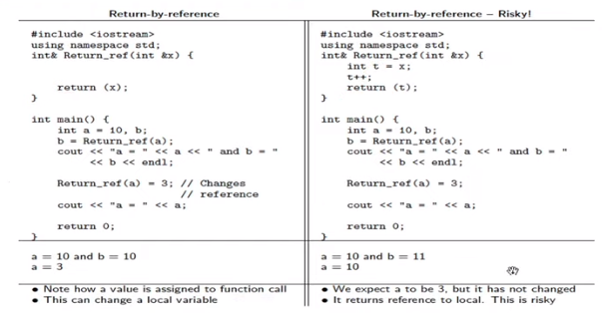
References as Return values

Slide 41
References as Return values
Important Points to Remember When Returning by Reference
Ordinary function returns value but this function doesn't. Hence, we cannot return a constant from the function
int& test() {
return 2; }
We cannot return a local variable from this function
int& test() {
int n = 2;
return n; }

Slide 42
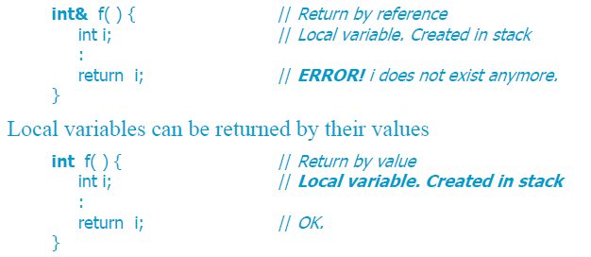
Never return a local variable by Reference
Since a function that uses “return by reference” returns an actual memory address, it is important that the variable in this memory location remain in existence after the function returns
When a function returns, local variables go out of existence and their values are lost

Slide 43
Inline Functions
Macros and inline functions are two very different programming constructs but their purpose and behavior are very similar
Macros
  (a) macros are still processed by the preprocessor and
  (b) macros are still nothing more than textual replacement (i.e., one sequence of characters is replaced by another sequence)
Inline functions
  are a more modern addition to C++ that are easier to use and are more robust

Slide 44
Inline Functions
C++ provides inline keyword
A new copy of the function to be inserted in each place it is called
  An inline function, is not called in the conventional sense at all. Instead, in a process known as inline expansion, the compiler replaces every call to the function with the actual code of the function itself
Inline reduces the overhead of a function calls
Program becomes larger
  if the function is called from multiple places in the program, the entire body of its code will be inserted multiple times, increasing the size of the program
Unlike macros they have type checking rules and scope

Slide 45
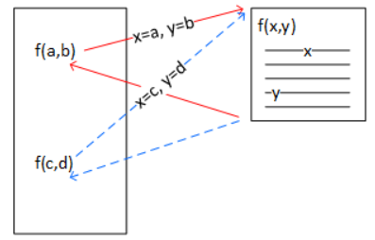
Inline Functions
Only one copy of the function's instructions exist in the program and those instructions are executed each time the function is called

Slide 46
Inline Functions
Normal functions have two important characteristics that set them apart from macros and inline functions
  The program contains just one copy of the function's machine instructions
  Program control shifts to the function's machine instructions whenever the function is called and returns to the statement following the call when the function ends

Slide 47
Inline Functions
  A stack frame is pushed onto the runtime stack; the frame is large enough to hold the return address and all of the function parameters
  The return address (the address of the instruction following the function call) is saved in the stack frame
  The function arguments are evaluated and passed to the function parameters by copying them to the stack frame
  Control jumps to the function instructions (i.e., the program counter is set to first machine instruction generated from the function's body)
  The computer executes all of the function's machine instructions
  Control jumps back to the saved address when the function ends
  If there is a return value, it is used or stored
  The stack frame is deallocated
  Execution continues with the instructions following the call

Slide 48
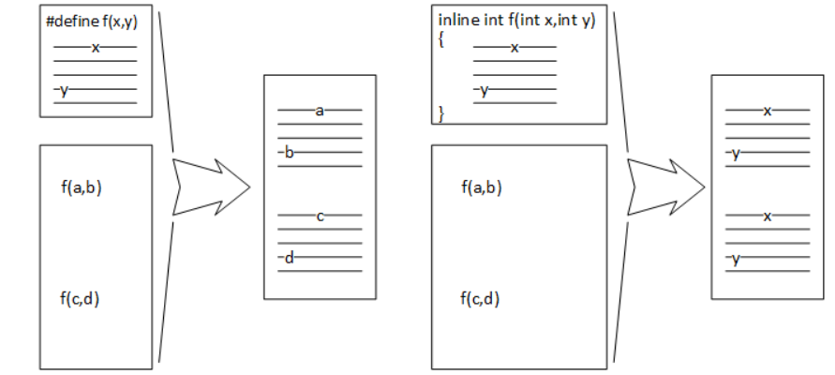
Macro Vs Inline Functions
(a) Macro (b) inline function

Slide 49
Macro Vs Inline Functions
The preprocessor expands macros by replacing the macro (e.g., "f(x,y)") with the statements in the macro body. The character or characters represented by a and b (including operators) replace x and y in the expansion. There is a copy of the macro statements for every occurrence of the macro in the source code
Inline functions are also expanded and replace the function call, but it is the compiler and not the preprocessor that performs the expansion. Like a macro, there is one copy of the function body for every function call in the source code. However, like a "normal" function and unlike a macro, the arguments are evaluated and the resulting value is passed to the function parameters before the expansion takes place

Slide 50
Macro Vs Inline Functions
#include <iostream>
using namespace std;
#define SQR(x) (x) * (x)
int sqr(int n)
{ return n*n; }
main()
{
int a=3, b=3, r, s;
r=SQR(++a); // (++a) * (++a)
s=sqr(++b);
cout <<"r="<<r<<"\t"<<"s="<<s;
}
Outptut
r=25 s=16

Slide 51
Inline Vs Macros
Inline | Macros
Part of language easy to debug | Difficult to debug
Not always expanded | Always Expanded
Has type checking rules and scope | Does not have these
Compile time | Preprocessing
Syntax
inline return-type function-name(parameters)
{
// function code
}

Slide 52
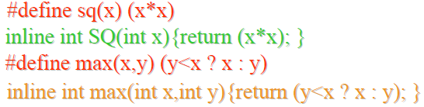
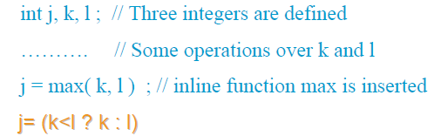
Inline Functions
An inline function is defined using almost the same syntax as an ordinary function.
Instead of placing the function’s machine-language code in a separate location, the compiler simply inserts it into the location of the function call

Slide 53
Inline Functions
Note :
  inline is a suggestion that the compiler may choose to ignore
  As the body of the function is copied every time the functions is called, inlining is only appropriate for very small functions (1-4 statements and some compilers disallow loops)

Slide 54
Function Overloading
C++ enables several functions of the same name to be defined, as long as these functions have different sets of parameters (at least as far as the parameter types or the number of parameters or the order of the parameter types are concerned) - This capability is called function overloading
When an overloaded function is called, the C++ compiler selects the proper function by examining the number, types and order of the arguments in the call
Function overloading is commonly used to create several functions of the same name that perform similar tasks, but on data of different types
  For example, many functions in the math library are overloaded for different numeric data types

Slide 55
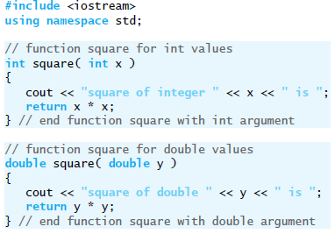

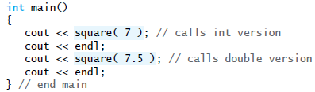
Function Overloading - Example
Output

Slide 56
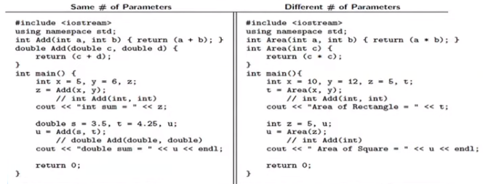
Function Overloading - Example
Defining multiple functions having the same name
Binding happens at compile time

Slide 57
How the Compiler Differentiates Overloaded Functions?
Overloaded functions are distinguished by their signatures - a combination of a function’s name and its parameter types (in order)
int area(float );
int area (int) ;
The compiler encodes each function identifier with the number and types of its parameters (sometimes referred to as name mangling or name decoration) to enable type-safe linkage
  This ensures that the proper overloaded function is called and that the argument types conform to the parameter types

Slide 58
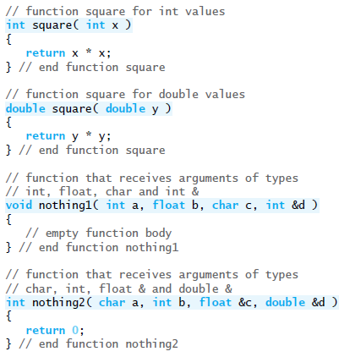


Name Mangling - Example
Name mangling to enable
type-safe linkage

Slide 59
Name Mangling - Example
Each mangled name (other than main) begins with two underscores (__) followed by the letter Z, a number and the function name
The number that follows Z specifies how many characters are in the function’s name
  For example : Function square has 6 characters in its name, so its mangled name is prefixed with __Z6
The function name is then followed by an encoding of its parameter list
  In the parameter list for function nothing2, c represents a char, I represents an int, Rf represents a float & (i.e., a reference to a float) and Rd represents a double & (i.e., a reference to a double)
The return types of the functions are not specified in the mangled names

Slide 60

Function Overloading
Note:
Function-name mangling is compiler specific
Function main is not mangled, because it cannot be overloaded
Example
  double abs(double);
  int abs(double);
  Function different only in return types cannot be overloaded

Slide 61
Function Overloading
int f(int i)
{
//..
}
int f(int &r) // error; function types not sufficiently different
{
//..
}
Any type T, a T and a T& accept the same set of initializer values, function with arguments types differing only in this respect may not have the same name

Slide 62
Function Overloading
Passing constant values directly can also lead to ambiguity as internal type conversions may take place
Example
sum(int, int)
sum(float, float)
The compiler will not be able to distinguish between the two calls made below
sum(2,3);
sum(1.1, 2.2);

Slide 63
Function Overloading – Summary of Rules
The same function name may be used in several definitions
Functions with the same name must have different number of formal parameters and/or different type of formal parameters
Function selection is based on the number and types of the actual arguments at the places of invocation
Function selection (overload resolution) is performed by the compiler
Two functions having the same signature but different return types will result in a compilation error due to attempt to re-declare
Overloading allows static polymorphism

Slide 64
Resolving Function Overloads
void f(double d1, int i1)
{... }
void f(double d1, double d2)
{... }
...
int main( )
{ cout << f(1.0, 2); }
How does the compiler know which version of f() to call?
Gather all the functions in the current scope that have the same name as the function called
Exclude those that don't have the right number of parameters to match the arguments in the call. (It has to be careful about parameters with default values; void f(int x, int y = 0) is a candidate for the call f(25);)
If no function matches, the compiler reports an error
If there is more than one match, select the 'best match'
If there is no clear winner of the best matches, the compiler reports an error - ambiguous function call

Slide 65
Overload Resolution
To resolve overloaded functions
  Identify the set of candidate functions
  From the set of candidate functions identify the set of viable functions
  Select the best viable function through (order is important)
    Exact Match
    Promotion
    Standard type conversion
    User defined type conversion

Slide 66
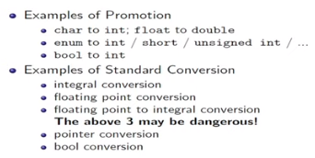
Overload Resolution - Promotion & Conversion

Slide 67
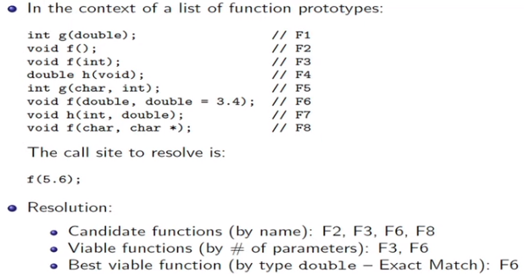
Example : Overload Resolution with One Parameter

Slide 68
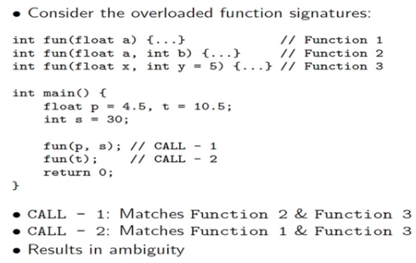
Example : Overload Resolution Fails

Slide 69
Function Overloading
Which of the following overloaded functions are NOT allowed in C++?
Function declarations that differ only in the return type
int fun(int x, int y);
void fun(int x, int y);
Functions that differ only by static keyword in return type
int fun(int x, int y);
static int fun(int x, int y);
Parameter declarations that differ only in a pointer * versus an array[ ]
int fun(int *ptr, int n);
int fun(int ptr[ ], int n);
Two parameter declarations that differ only in their default arguments
int fun( int x, int y);
int fun( int x, int y = 10);
Ans : None of the above overloaded functions are allowed

Slide 70
Default Arguments
It’s not uncommon for a program to invoke a function repeatedly with the same argument value for a particular parameter. In such cases, you can specify that such a parameter has a default argument, i.e., a default value to be passed to that parameter
When an argument for a parameter with a default argument in a function call is omitted, the compiler rewrites the function call and inserts the default value of that argument to be passed as an argument in the function call
Default arguments must be the rightmost (trailing) arguments in a function’s parameter list
Default arguments should be specified with the first occurrence of the function name— function prototype
If the function prototype is omitted , then the default arguments should be specified in the function header

Slide 71

Default Arguments
Default values can be any expression, including constants, global variables or function calls
Default arguments also can be used with inline functions
#include <iostream>
using namespace std;
int boxVolume( int length = 1, int width = 1, int height = 1 );
int main()
{
cout << boxVolume();
cout << boxVolume(10);
cout << boxVolume(10, 5);
cout << boxVolume(10, 5, 2);
}
int boxVolume( int length, int width, int height )
{
return length * width * height;
}

Slide 72
Default Arguments
Four rules that must be followed when using default arguments
  Rule 1 : No argument without a default may be defined to the right of an argument with a default
  Rule 2: When calling a function with default arguments, an argument may not be specified to the right of an argument whose default is accepted
  Rule 3: If the function definition and the function declaration are not the same, then the default values appear in function prototypes
  Rule 4 : If a function with default arguments is also overloaded, all possible ways that the function can be called with and without default values must be distinct from any and all overloaded versions

Slide 73
Default Arguments
Rule 1
  void function(int a, int b = 1, int c = 2); // okay
  void function(int a, int b = 1, int c); // error
Rule 2
  function(50); // okay
  function(60, 70); // okay
  function(60, 70, 80); // okay
  function(60, , 80); // error
Rule 3
  void function(int a, int b = 1, int c = 2);

Slide 74
Default Arguments
Rule 4
  void function(); // version 1
  void function(int a, int b = 1, int c = 2); // version 2
  The two functions described by the following prototypes violate rule 4:
  void function(int a); // version 1
  void function(int a, int b = 1, int c = 2); // version 2
  The problem is demonstrated by the following function call:
  function(10); // version 1 or 2?
function(); // version 1
function(10); // version 2
function(10, 20); // version 2
function(10, 20, 30); // version 2

Slide 75
Default Function Arguments
A C++ function can have default values for some of the parameters
#include<iostream.h>
void function_2(int i,int j=2);
main(void)
{
int i=1;
int j=5;
function_2(i,j);
function_2(j);
}
void function_2(int i,int j)
{ cout<<“i is “<<i<<‘\n’;
cout<<“j is “<<j<<‘\n’;
}
Function Prototype
Default value for j
Output:
i is 1
j is 5
i is 5
j is 2
Function Definition

Slide 76
Default Function Arguments
What happens if j is initialized at the time that function is called???
#include<iostream.h>
void function_2(int i, int j=2);
main(void)
{
int i=1;
int j;
function_2(i, j=8);
}
void function_2(int i, int j)
{ cout<<“i is “<<i<<‘\n’;
cout<<“j is “<<j<<‘\n’;
}
Output:
i is 1
j is 8

Slide 77
Default Function Arguments
#include<iostream.h>
void function_2(int i,int j=2);
main(void)
{
int i;
function_2(i);
}
void function_2(int i,int j=8)
{
cout<<“i is “<<i<<‘\n’;
cout<<“j is “<<j<<‘\n’;
}
?
Error: previously specified default argument cannot be changed in the function

Slide 78
Default Function Arguments
Default values provides flexibility
Functions called with same arguments can be given default values
#include<iostream.h>
void print(int value, int base=10);
void main()
{
print(31);
print(31,10);
print(31,16);
print(31,2);
}

Slide 79
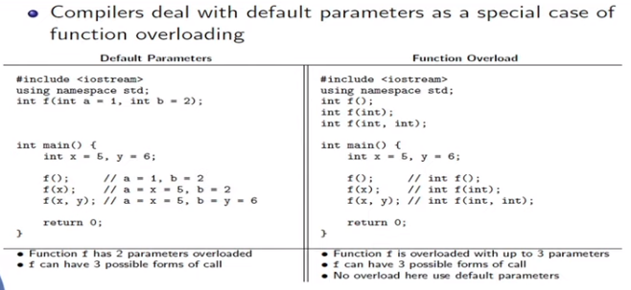
Default Parameter and Function Overloading

Slide 80
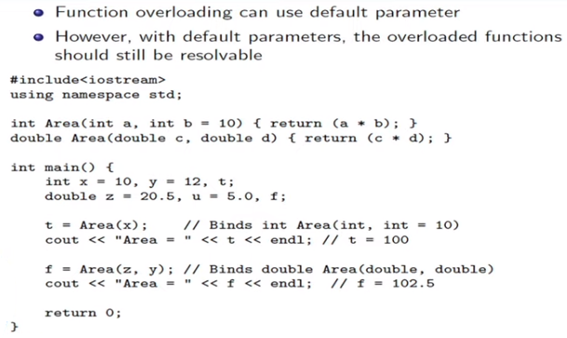
Default Parameter and Function Overloading

Slide 81
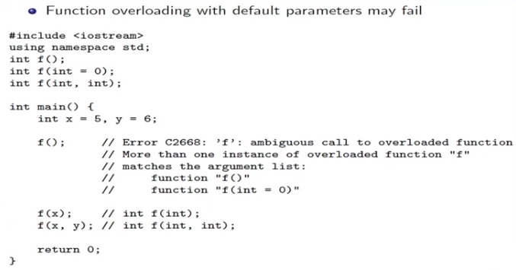
Default Parameter and Function Overloading

